Slide 1


numerical Methods
Notes:
Note: After adding your pictures, right click on it and “Send To Back”.

Slide 2

linear equations

Slide 3

Elementary operations on matrices
Rows replacement
Multiplying a row by a scalar
Adding another line to a row

Slide 4
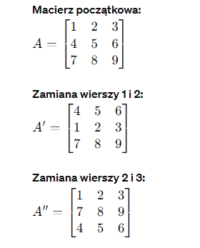
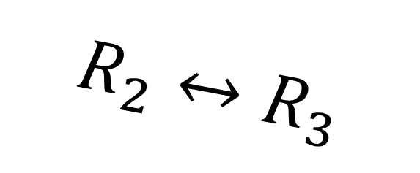
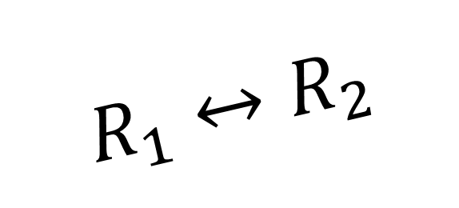
Elementary operations on matrices
Rows replacement
$$R_{1}↔R_{2}$$
$$R_{2}↔R_{3}$$

Slide 5
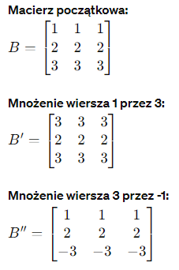
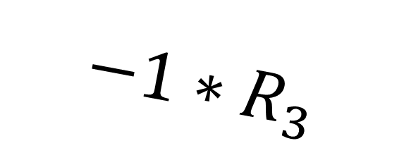
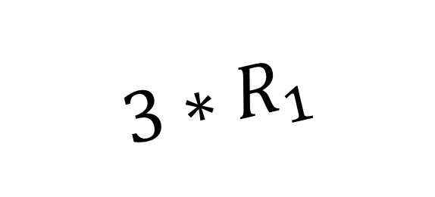
Elementary operations on matrices
Multiplying a row by a scalar
$${3∗R}_{1}$$
$$−1∗R_{3}$$

Slide 6
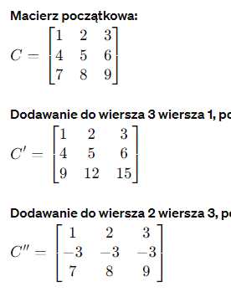
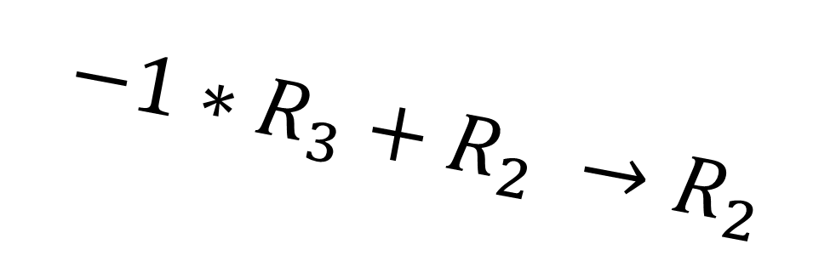
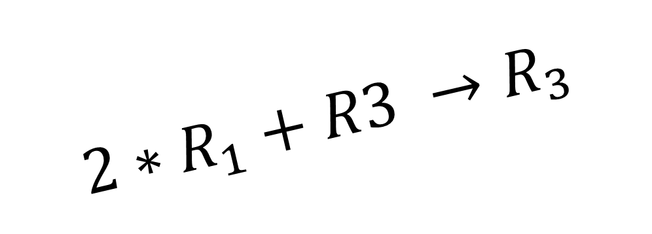
Elementary operations on matrices
Adding another row to the row
$${2∗R}_{1}+R3 →R_{3}$$
$${−1∗R}_{3}+R_{2} →R_{2}$$

Slide 7
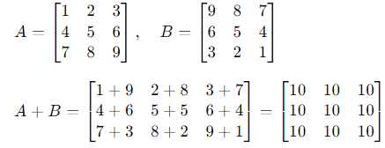
Elementary operations on matrices
Adding two matrices

Slide 8
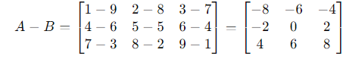
Elementary operations on matrices
Difference of two matrices

Slide 9
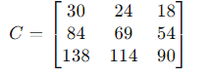
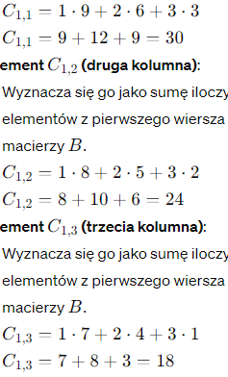
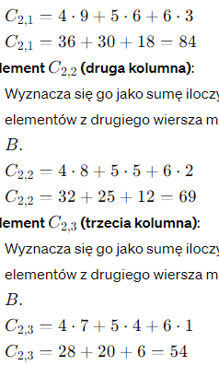

Elementary operations on matrices
Multiplying two matrices
$$A∗B=C$$

Slide 10
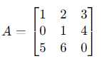
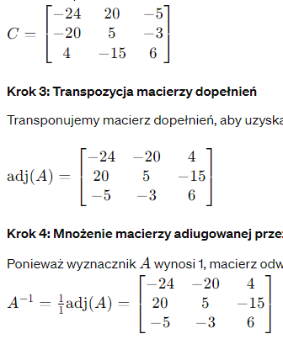
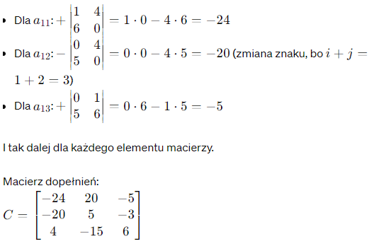










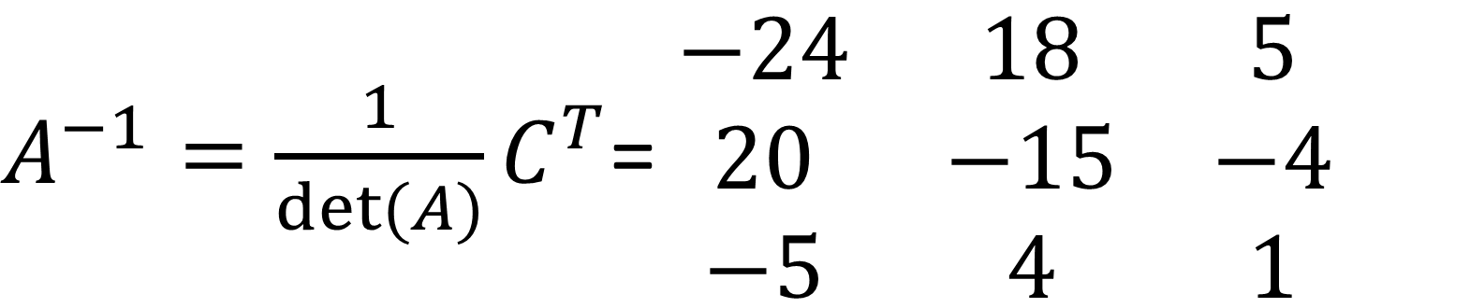

Elementary operations on matrices
Calculating the inverse matrix
$$A^{−1}$$
$A^{−1}=\frac{1}{det⁡(A)}C^{T}$= $\begin{matrix}−24 & 18 & 5 \\ 20 & −15 & −4 \\ −5 & 4 & 1\end{matrix}$

Slide 11
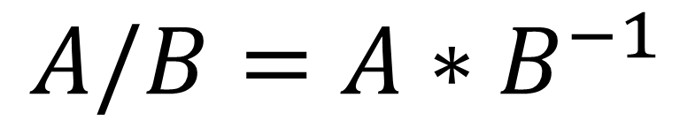
Elementary operations on matrices
Dividing two matrices by each other
$$A/B=A∗B^{−1}$$

Slide 12
Solving systems of equations
Direct methods - after a finite number of steps, provide an exact solution, provided there are no rounding errors.
The direct method is the Gaussian elimination method
This is the most famous direct method for solving systems of equations.

Slide 13
Solving systems of equations
Direct methods - after a finite number of steps, provide an exact solution, provided there are no rounding errors.
The direct method is the Gaussian elimination method
This is the most famous direct method for solving systems of equations.
The classic Gaussian elimination method consists of the following steps:
Reducing matrix A to a triangular form
Calculating subsequent elements of X by reverse substitution.

Slide 14
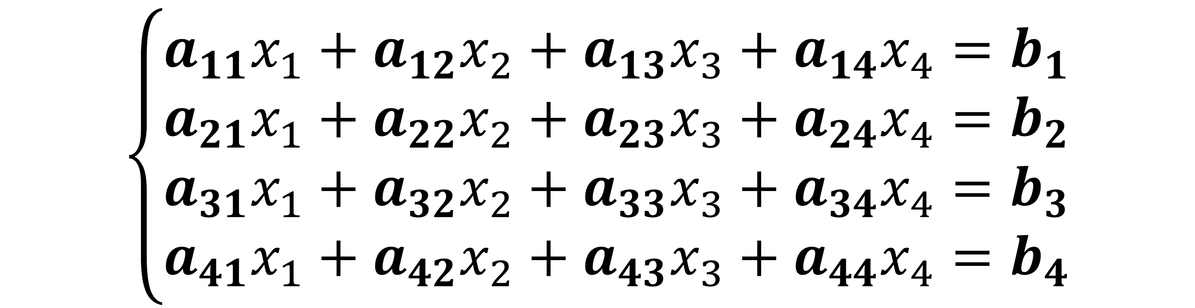
Solving systems of equations
$$\left\{\begin{aligned}a_{11}x_{1}+a_{12}x_{2}+a_{13}x_{3}+a_{14}x_{4}=b_{1} \\ a_{21}x_{1}+a_{22}x_{2}+a_{23}x_{3}+a_{24}x_{4}=b_{2} \\ a_{31}x_{1}+a_{32}x_{2}+a_{33}x_{3}+a_{34}x_{4}=b_{3} \\ a_{41}x_{1}+a_{42}x_{2}+a_{43}x_{3}+a_{44}x_{4}=b_{4}\end{aligned}\right.$$

Slide 15
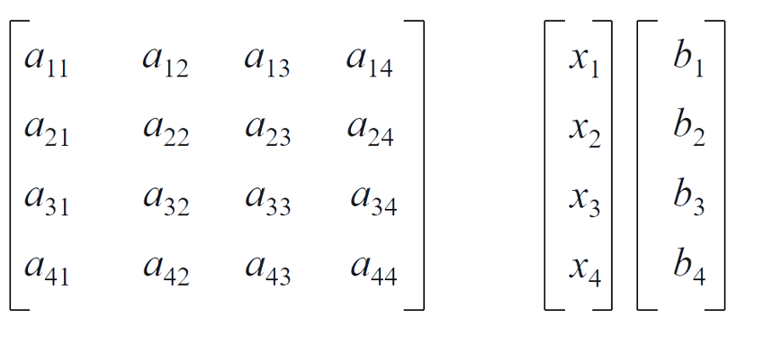
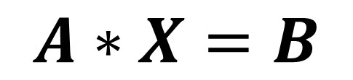

Solving systems of equations
$$\left\{\begin{aligned}a_{11}x_{1}+a_{12}x_{2}+a_{13}x_{3}+a_{14}x_{4}=b_{1} \\ a_{21}x_{1}+a_{22}x_{2}+a_{23}x_{3}+a_{24}x_{4}=b_{2} \\ a_{31}x_{1}+a_{32}x_{2}+a_{33}x_{3}+a_{34}x_{4}=b_{3} \\ a_{41}x_{1}+a_{42}x_{2}+a_{43}x_{3}+a_{44}x_{4}=b_{4}\end{aligned}\right.$$
$$A∗X=B$$

Slide 16
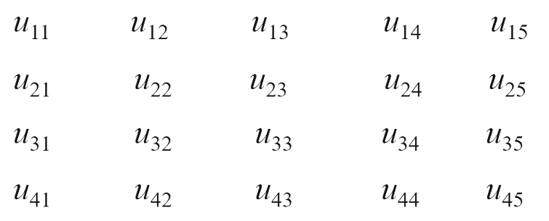
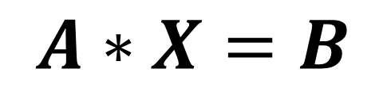
Solving systems of equations
$$A∗X=B$$

Slide 17
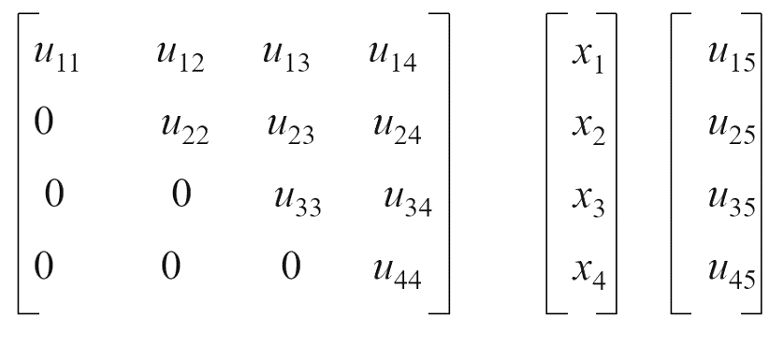
Solving systems of equations
$$A∗X=B$$

Slide 18
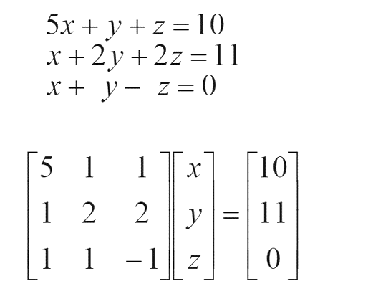
Solving systems of equations

Slide 19
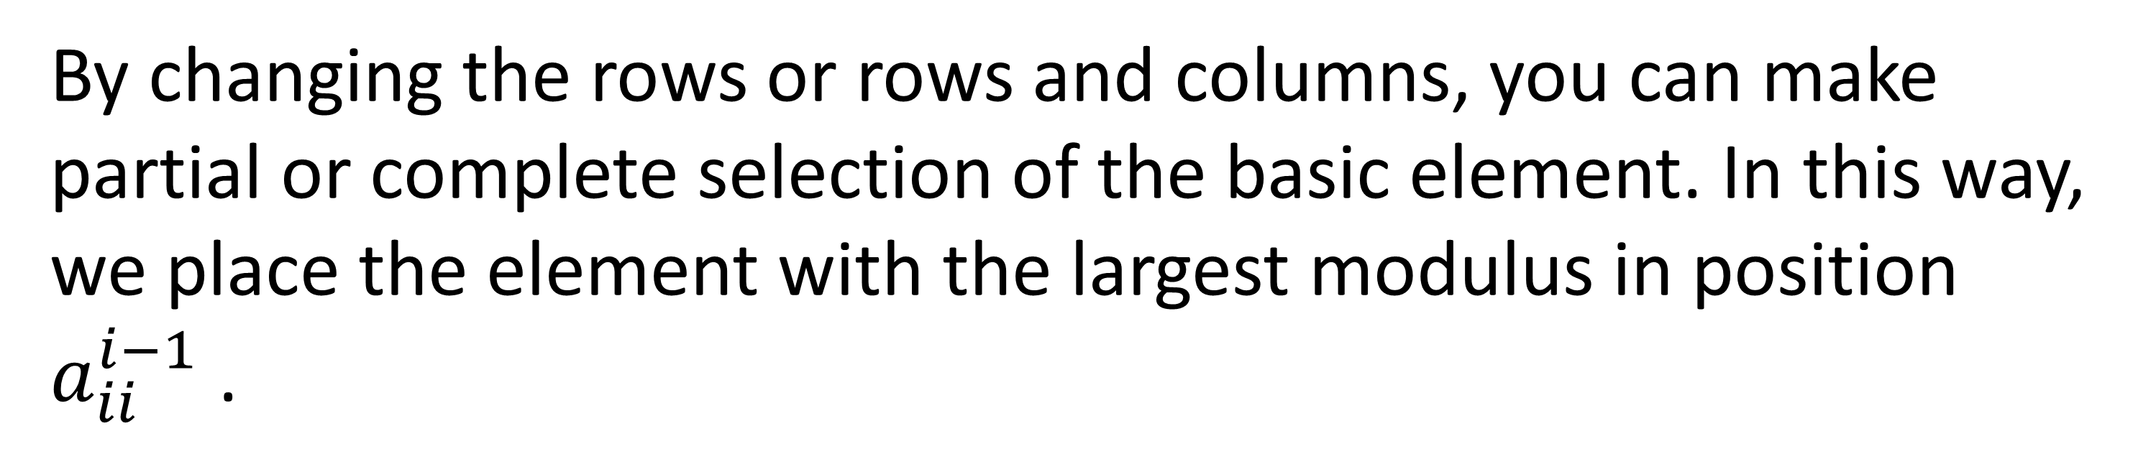
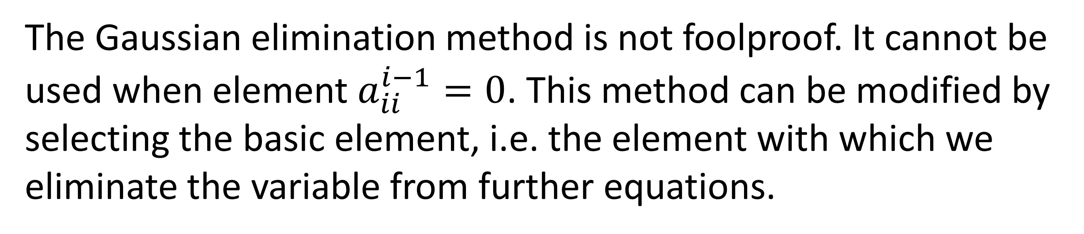
Solving systems of equations
The Gaussian elimination method is not foolproof. It cannot be used when element $a_{ii}^{i−1}=0$. This method can be modified by selecting the basic element, i.e. the element with which we eliminate the variable from further equations.
By changing the rows or rows and columns, you can make partial or complete selection of the basic element. In this way, we place the element with the largest modulus in position $a_{ii}^{i−1}$.

Slide 20
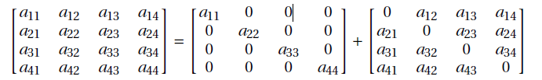










Simple iteration method
The simple iteration method comes from a relatively easy transformation of the system of equations:
$$A X=B$$
To avoid matrix inversion it can be expressed as
$$A =P+N$$

Slide 21



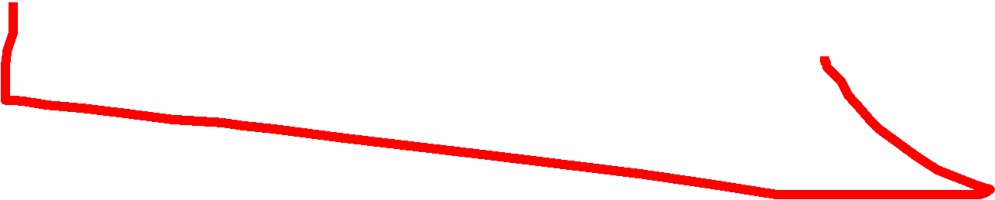
















Simple iteration method
$$A x=b \\ \left(P+N\right)x=b$$
$$Px+Nx=b \\ Px=b−Nx$$
$$X=P^{−1}b −P^{−1}Nx$$
We create an iterative dependency:
$$X_{i+1}=P^{−1}b −P^{−1}N x_{i}$$

Slide 22
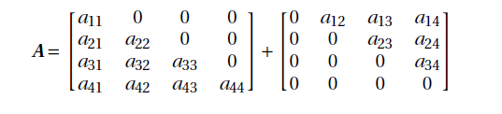
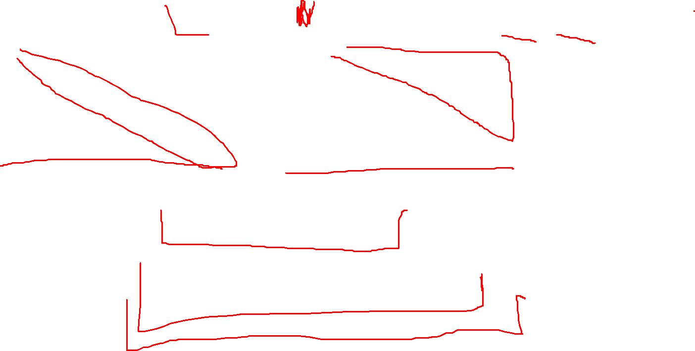
Gauss-Seidel method
It is based on a similar transformation
$$Ax=bx$$
$$A=L+U$$
$$Lx=b−Ux$$
$$x_{k+1}=L^{−1}(b−Ux_{k})$$

Slide 23
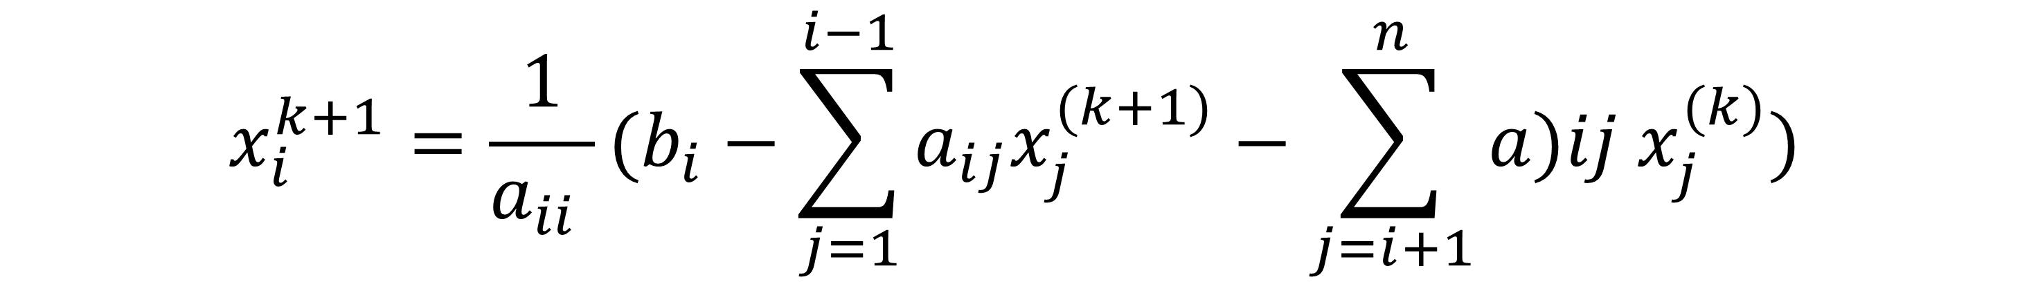
Gauss-Seidel method
It is based on a similar transformation
$$Ax=bx$$
$$A=L+U$$
$$Lx=b−Ux$$
$$x_{k+1}=L^{−1}(b−Ux_{k})$$
$$x_{i}^{k+1}=\frac{1}{a_{ii} }(b_{i}−\sum_{j=1}^{i−1}{a_{ij}x_{j}^{(k+1)}}−\sum_{j=i+1}^{n}{a)ij x_{j}^{(k)})}$$

